Slide 1


SIR C R REDDY COLLEGE OF ENGINEERING, ELURU
Approved by AICTE & Permanently Affiliated to JNTUK, Kakinada
Accredited by NBA, Accredited by NAAC with ‘A’ Grade
DEPARTMENT OF COMPUTER SCIENCE & ENGINEERING
PROJECT CREDITS
TANNA NAGA SRI DURGA MALLESH (21B81A05G7)
PROJECT GUIDE
M. Ganesh Babu, M.Tech
Asst. Professor, CSE
Department of Computer Science and Engineering
Sir C R Reddy College of Engineering

Slide 2


Smart Re-admit: AI-powered Patient Re-admission Predictor

Slide 3
Introduction
Hospital re-admissions shortly after discharge are a major concern, often leading to increased healthcare costs, burdened medical staff, and reduced quality of patient care. To address this, our project presents a machine learning-based solution that predicts the likelihood of patient re-admission using Electronic Health Records (EHRs).
We developed an AI-powered prediction system using advanced models like XGBoost, Random Forest, Neural Networks, and LSTM. The system includes thorough data preprocessing, handles class imbalance using SMOTE and SMOTEENN, and tunes models for optimal accuracy. This allows hospitals to proactively identify high-risk patients and take preventive actions—ultimately improving patient outcomes and optimizing hospital resources.

Slide 4

The Problem : Hospital Re-admissions
Patient re-admission is a significant challenge for healthcare providers, leading to increased operational costs and negative patient outcomes. The goal of the proposed system is to predict the likelihood of a patient being re-admitted within a specific timeframe (e.g., after 30 days) by analyzing historical patient records. This predictive capability allows hospitals to take preventive actions and reduce unnecessary re-admissions.

Slide 5

Predict patient re-admissions using machine learning techniques to improve healthcare outcomes and reduce hospital costs.
Utilize EHR data to build a reliable dataset based on patient demographics, diagnoses, procedures, and treatment history.
Preprocess data effectively using techniques like normalization, encoding, and imputation to ensure model-ready input.
Address class imbalance through SMOTEENN to enhance model generalization and fairness.
Train and compare models such as Logistic Regression, Random Forest, XGBoost, and Neural Networks.
Tune hyperparameters using RandomizedSearchCV to optimize each model's performance.
Analyze feature importance to identify the most influential factors affecting re-admission risk.
Deploy a user-friendly interface via Streamlit for real-time prediction and clinical use.
Objectives

Slide 6
Existing System
Most existing hospital re-admission systems rely on manual rules or simple logistic regression models.
These approaches often struggle with imbalanced data and fail to capture complex patient patterns, resulting in suboptimal prediction performance.

Slide 7
Proposed System
The proposed system uses machine learning models (XGBoost, Random Forest, MLP, and LSTM) trained on Electronic Health Records (EHR).
It includes data preprocessing, feature scaling, class balancing (SMOTE, SMOTEENN), and hyperparameter tuning.
The system achieves high accuracy (89.03%) and provides healthcare professionals with early insight into patients at high risk of re-admission.

Slide 8
Architecture
System Architecture Overview
1. Data Collection & Ingestion
Sources: Electronic Health Records (EHRs), including patient demographics, medical history, lab results, and treatment data.
Storage: Secure databases or cloud storage solutions (e.g., AWS S3, Azure Blob Storage) to house raw data.
2. Data Preprocessing
Cleaning: Handling missing values, correcting inconsistencies, and removing duplicates.
Transformation: Encoding categorical variables, normalizing numerical features, and feature selection.
Balancing: Applying techniques like SMOTE or SMOTEENN to address class imbalance in the dataset.
3. Model Development
Algorithms: Training multiple machine learning models such as Logistic Regression, Random Forest, XGBoost, and Neural Networks.
Optimization: Utilizing hyperparameter tuning methods like RandomizedSearchCV to enhance model performance.
Validation: Employing cross-validation techniques to assess model generalizability.

Slide 9
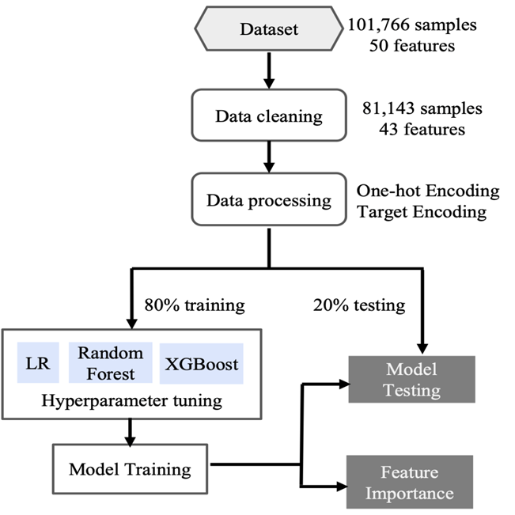
4. Model Evaluation Metrics: Assessing models using accuracy, precision, recall, F1-score, and ROC-AUC. Selection: Choosing the best-performing model based on evaluation metrics. 5. Deployment Interface: Developing a user-friendly application (e.g., using Streamlit) for healthcare professionals to input patient data and receive predictions. Integration: Connecting the application with hospital information systems for seamless data flow.

Slide 10
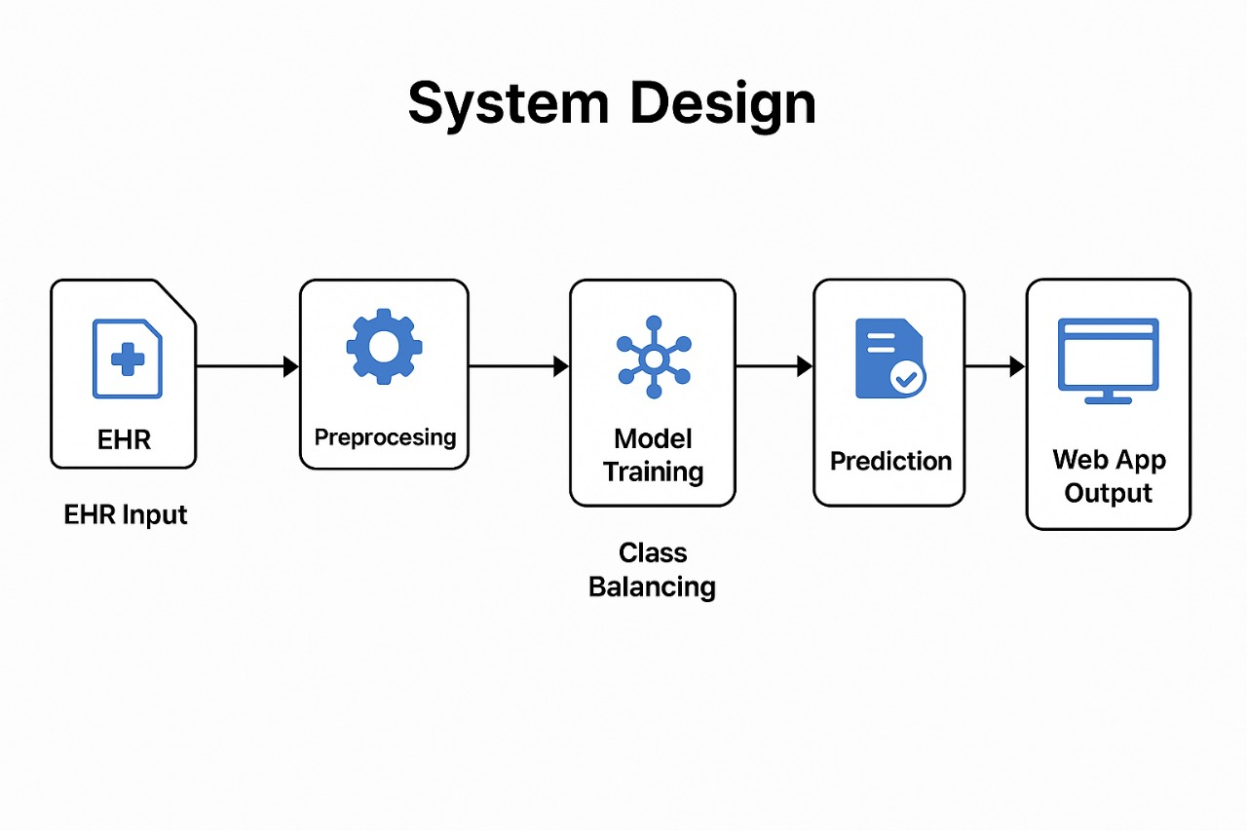

Slide 11
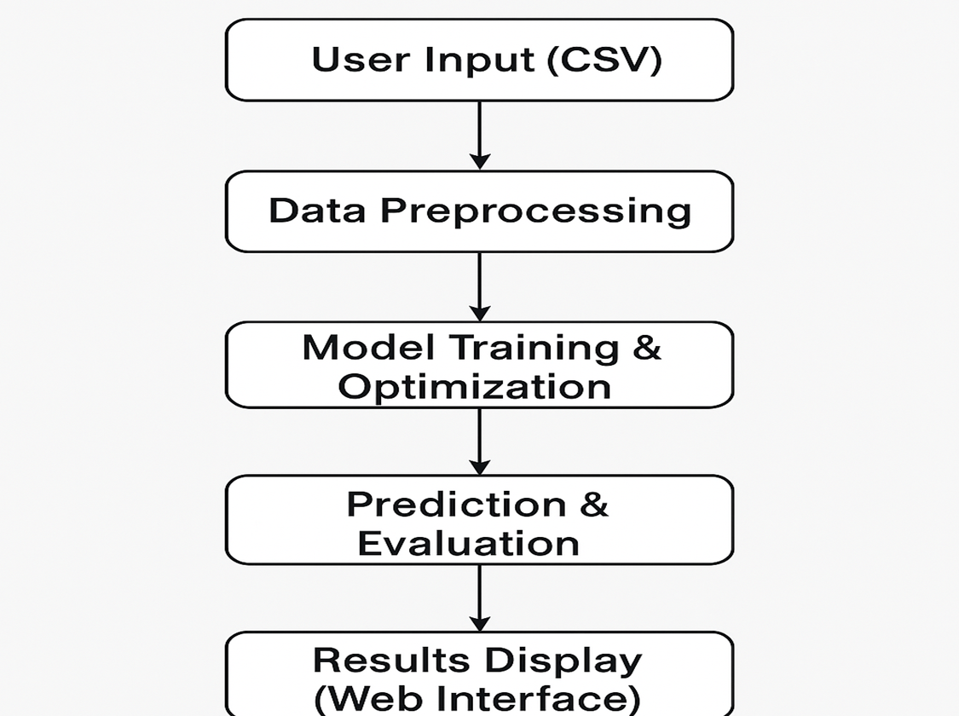
System Design
EHR Input Utilizing Electronic Health Records (EHR)
Preprocessing Data cleaning and preparation for analysis
Model Training Utilizing algorithms to train the model
Class Balancing Ensuring diverse data representation for accurate predictions
Prediction Making predictions based on the trained model
Web App Output Displaying results in a user-friendly web application format

Slide 12
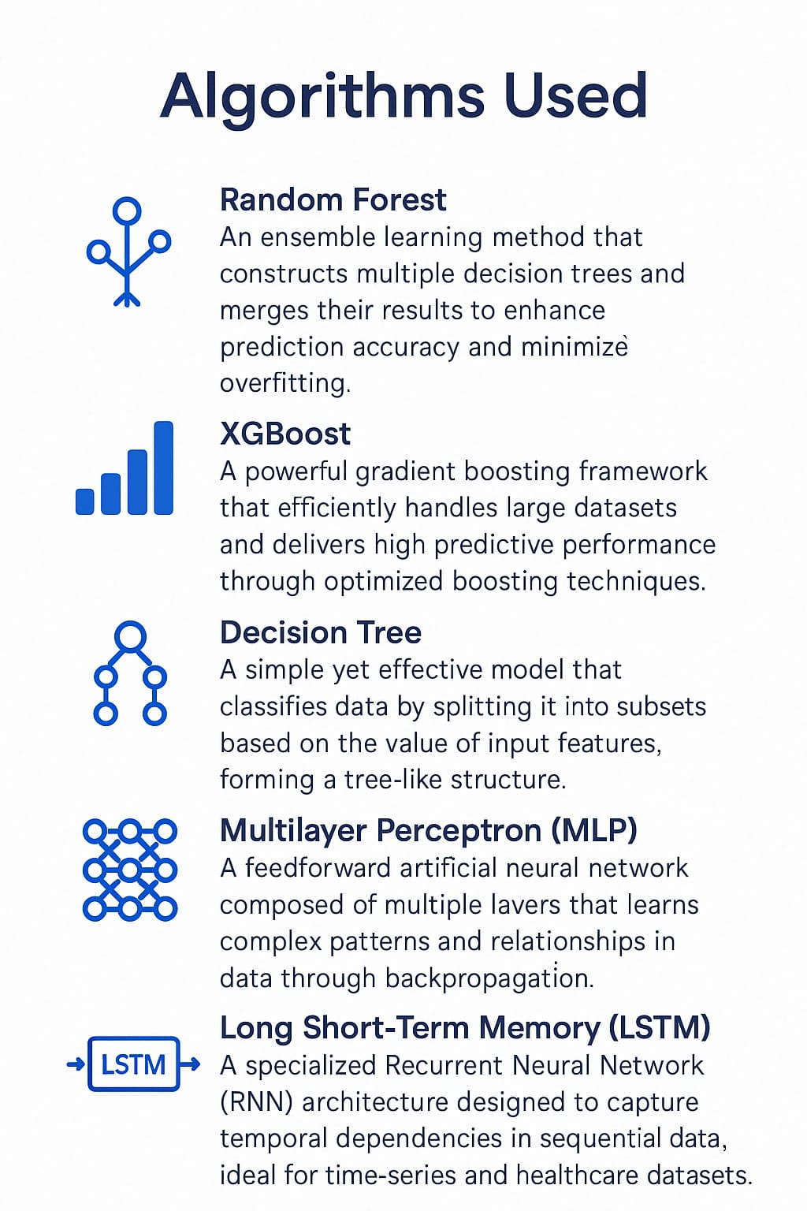
Algorithms used in the Architecture
Random Forest: Utilizes an ensemble of decision trees to improve prediction accuracy and reduce overfitting.
XGBoost: Implements optimized gradient boosting for high-performance predictions.
Decision Tree: A model that makes decisions based on feature splits to classify data.
Multilayer Perceptron (MLP): A deep learning model that captures complex, non-linear relationships in data.
Long Short-Term Memory (LSTM): A type of Recurrent Neural Network (RNN) designed for processing sequential data.

Slide 13
Sample Code
1. Data Preprocessing & Handling Missing Values :
import pandas as pd from sklearn.preprocessing import LabelEncoder
df = pd.read_csv("patient_data.csv")
# Handle missing values and encode categorical columns
df.replace(["?", "unknown"], np.nan, inplace=True)
df.fillna(df.mode().iloc[0], inplace=True)
for col in df.select_dtypes(include='object').columns:
df[col] = LabelEncoder().fit_transform(df[col])
2. Feature Scaling & Balancing with SMOTEENN
from sklearn.preprocessing import StandardScaler from imblearn.combine import SMOTEENN
X = df.drop("re-admitted", axis=1) y = df["re-admitted"] X = StandardScaler().fit_transform(X) X_resampled, y_resampled = SMOTEENN().fit_resample(X, y)
3. Train-Test Split & Model Training
from sklearn.model_selection import train_test_split from xgboost import XGBClassifier
X_train, X_test, y_train, y_test = train_test_split(X_resampled, y_resampled, test_size=0.2, random_state=42)
model = XGBClassifier(use_label_encoder=False, eval_metric="mlogloss") model.fit(X_train, y_train)
4. Prediction & Evaluation
From sklearn.metrics import accuracy_score
preds = model.predict(X_test) print("Accuracy:", accuracy_score(y_test, preds))

Slide 14
Test Cases:
Introduction :
To ensure the accuracy and robustness of our proposed system, we designed and conducted multiple test cases. These tests were aimed at validating each stage of the machine learning pipeline, from data input and preprocessing to model prediction and output display in the Streamlit interface.

Slide 15
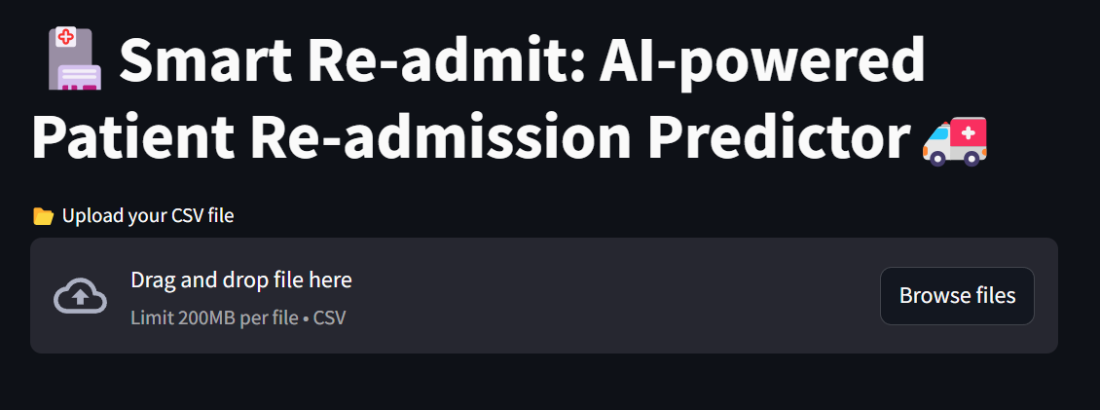
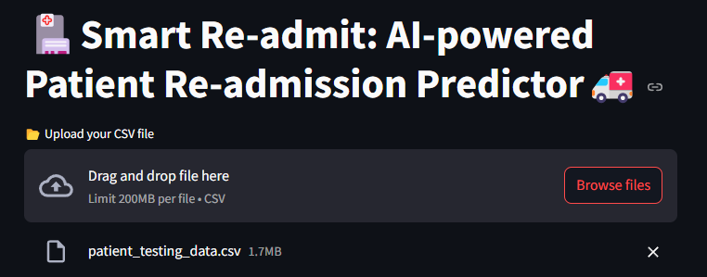
Test Case 1 : CSV Upload Validation
Input
Output
Screenshot for File Upload
Screenshot after uploading Dataset

Slide 16
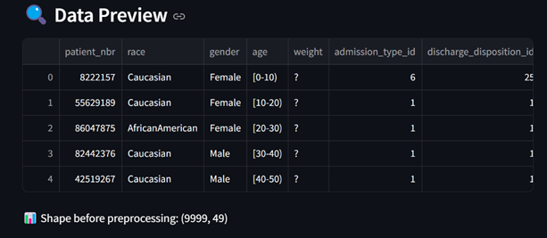
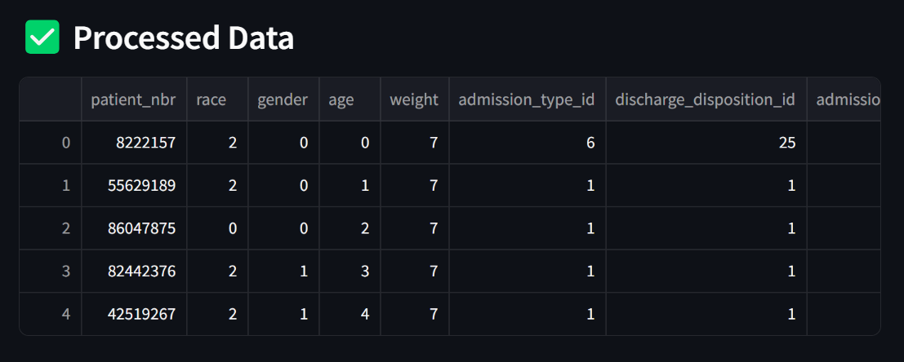
Test Case 2 : Data Preview & Processing
Input
Output
Data Preview
Processed Data

Slide 17
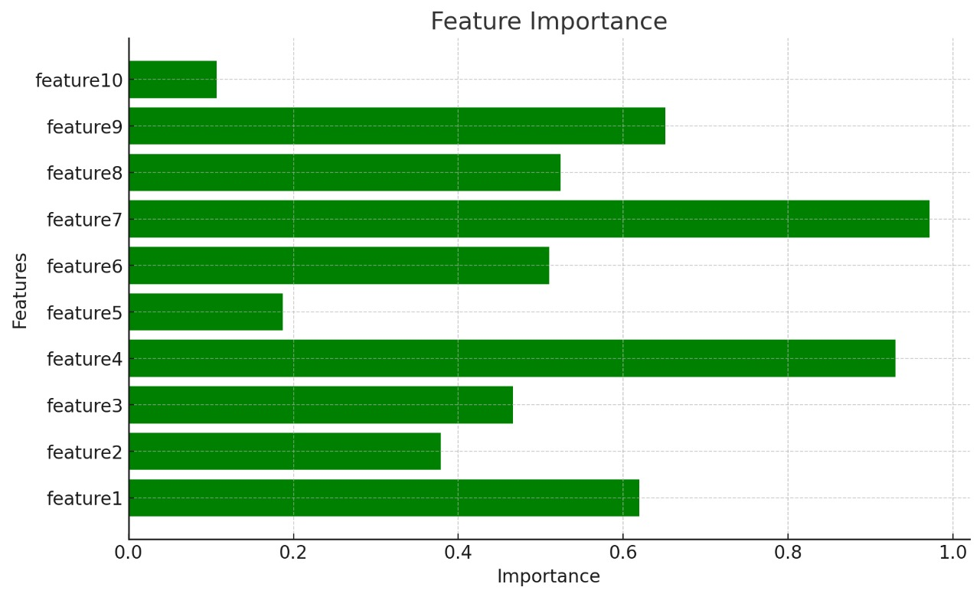
Test Case 3 : Feature Importance Visualization

Slide 18

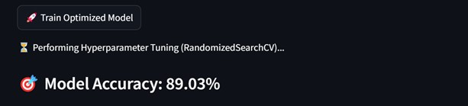
Results:
Model Accuracy:
Our proposed model, utilizing XGBoost, achieved an impressive accuracy of 89.03% on the patient dataset, demonstrating its effectiveness in predicting patient re-admissions. Additionally, the LSTM model showed solid performance by capturing temporal patterns, further validating the potential of deep learning techniques for healthcare predictive modeling.

Slide 19
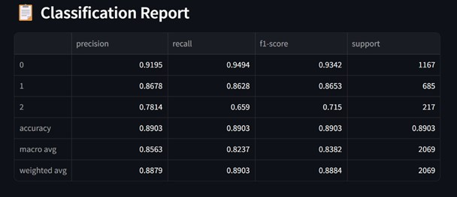
Classification Report
The proposed system demonstrates robust performance with a precision of 91.95% and recall of 94.94% for Class 0. The model achieves an overall accuracy of 89.03%. The macro average precision is 85.63%, and the weighted average F1-score is 88.84%, indicating balanced performance across both classes

Slide 20
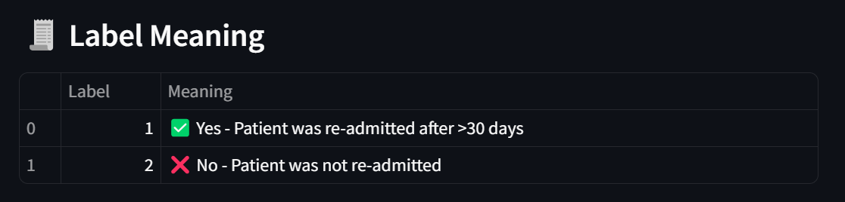
Label Definitions for Patient Re-admission
In this proposed system, the target variable 're-admitted' is encoded to reflect patient outcomes. Label 1 represents patients who were re-admitted after more than 30 days, while Label 2 corresponds to patients who were not re-admitted. This binary classification allows the model to effectively identify individuals at higher risk of future hospitalization, supporting timely and proactive healthcare interventions.

Slide 21
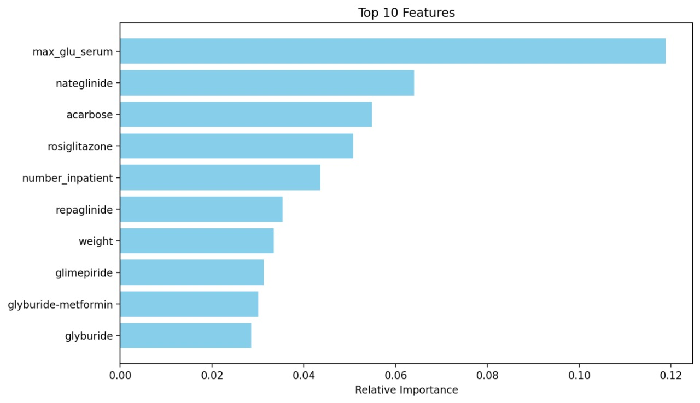
Top 10 Features

Slide 22

Conclusion
The proposed system effectively predicts patient re-admissions using EHR data, achieving a high accuracy of 89.03% with the XGBoost model.
It empowers healthcare providers with early insights to reduce re-admission rates and improve patient care outcomes.

Slide 23

Future Scope
Integrate the model into a user-friendly web application for hospital use.
Extend functionality through a mobile application for real-time access and decision support by healthcare professionals.
Incorporate live data streams to enable continuous learning and adaptive predictions.

Slide 24
Thank You Sir

